Slide 1
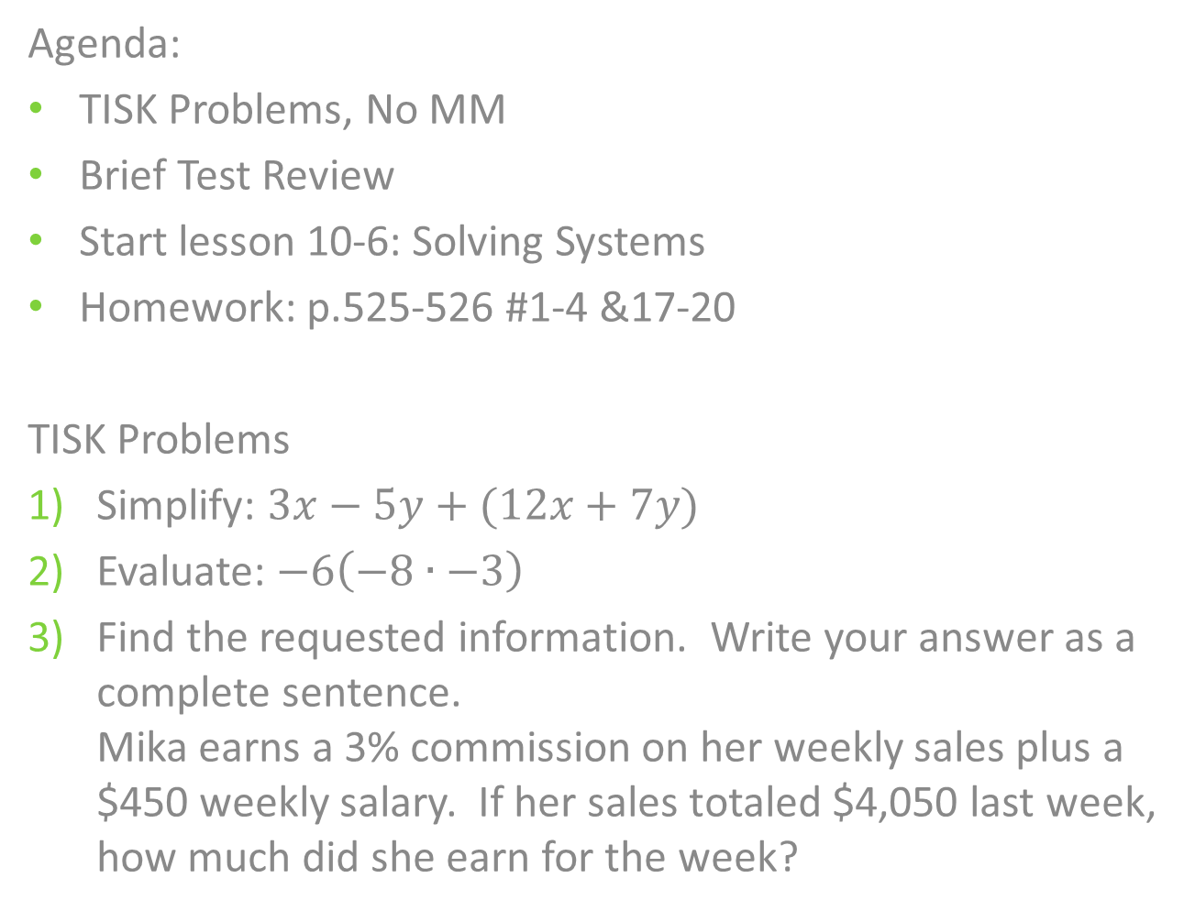
Monday, November 26, 2012
Agenda:
TISK Problems, No MM
Brief Test Review
Start lesson 10-6: Solving Systems
Homework: p.525-526 #1-4 &17-20
TISK Problems
Simplify: $3x−5y+(12x+7y)$
Evaluate: $−6\left(−8∙−3\right)$
Find the requested information. Write your answer as a complete sentence.
Mika earns a 3% commission on her weekly sales plus a $450 weekly salary. If her sales totaled $4,050 last week, how much did she earn for the week?

Slide 2
Chapter 9 Test
Class Averages:
  7D: 78.4%
  7B: 83.9%
  7C: 84.4%
Overall good work!
Remember that you can get your test signed for an additional 2 points of extra credit. Signatures are due one week from today; December 3.
Most issues were in the REVIEW section (problems 30-40)!

Slide 3




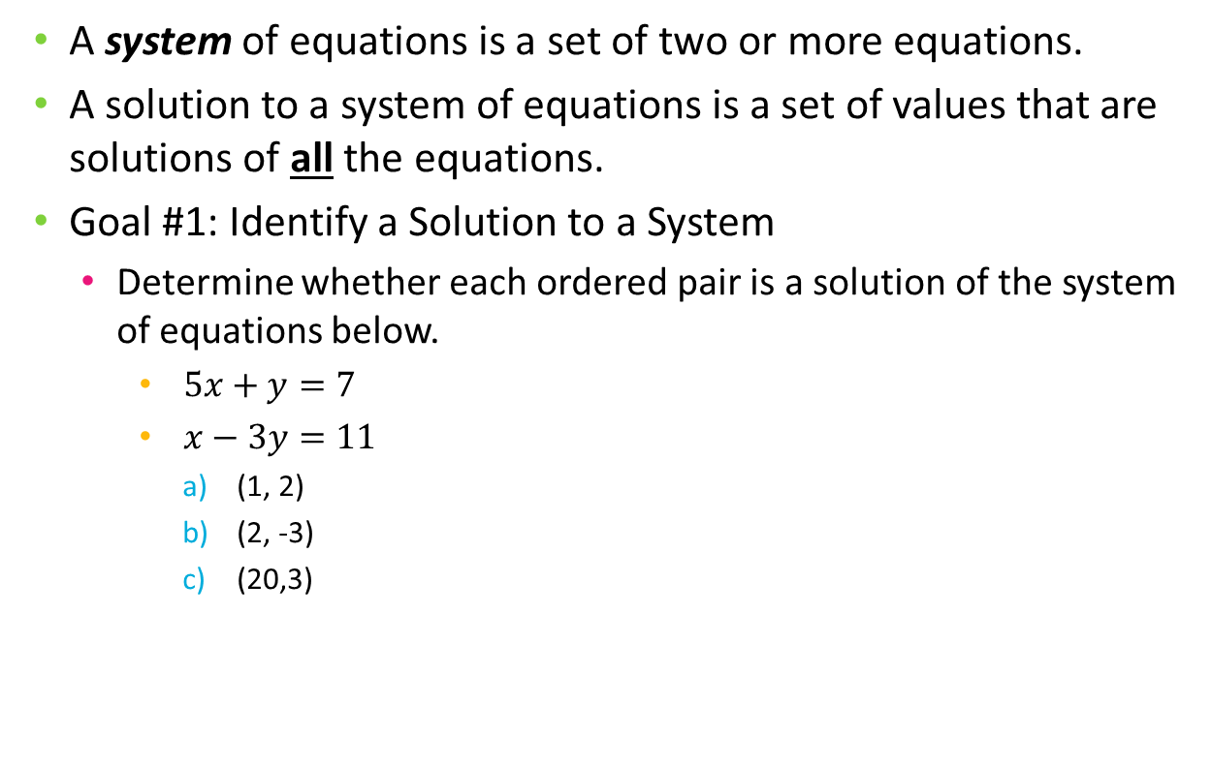
§10-6 Systems of Equations
A system of equations is a set of two or more equations.
A solution to a system of equations is a set of values that are solutions of all the equations.
Goal #1: Identify a Solution to a System
  Determine whether each ordered pair is a solution of the system of equations below.
    $5x+y=7$
    $x−3y=11$
      (1, 2)
      (2, -3)
      (20,3)
(1, 2)
Let $x=1$ and $y=2$.
$5x+y=7$
$5(1)+2=7$
$7=7$
$x−3y=11$
$1−3(2)=11$
$1−6=11$
$−5=11$

Slide 4






§10-6 Systems of Equations
  Determine whether each ordered pair is a solution of the system of equations below.
    $5x+y=7$
    $x−3y=11$
      (1, 2)
      (2, -3)
      (20,3)
(1, 2)
Let $x=1$ and $y=2$.
$5x+y=7$
$5(1)+2=7$
$7=7$
$x−3y=11$
$1−3(2)=11$
$1−6=11$
$−5=11$
No
Yes
No
(2, -3)
Let $x=2$ and $y=−3$.
$5x+y=7$
$5(2)+(−3)=7$
$10−3=7$
$7=7$
(20, 3)
Let $x=20$ and $y=3$.
$5x+y=7$
$5(20)+3=7$
$100+3=7$
$103=7$
$x−3y=11$
$2−3(−3)=11$
$2+9=11$
$11=11$

Slide 5
§10-6 Systems of Equations
You need ALL “Yes” answers for the ordered pair to be a solution.
You need only ONE “No” for the ordered pair to NOT be a solution.

Slide 6

§10-6 Systems of Equations
You try it.
Determine if the ordered pair is a solution of the system.
  $y=2x$
  $y=−4x+12$
  (2, 4)
  (-3,-6)
  (3,0)

Slide 7
§10-6 Systems of Equations
You try it.
Determine if the ordered pair is a solution of the system.
  $y=2x$
  $y=−4x+12$
  (2, 4)
  (-3,-6)
  (3,0)

Slide 8
§10-6 Systems of Equations
You try it.
Determine if the ordered pair is a solution of the system.
  $y=2x$
  $y=−4x+12$
  (2, 4)
  (-3,-6)
  (3,0)

Slide 9


Homework
Determine if the ordered pair is a solution of each system of equations.
(2, 3) $y=2x−1$
$y=x+1$
(2, 7) $y=5x−3$
$y=3x+1$
(2, 4) $y=4x−4$
  $y=2x$
(2, 2) $y=2x+1$
  $y=3x−2$
(0, 1) $y=−2x−1$
  $y=2x+1$
(5, 11) $y=3x−4$
  $y=2x+1$
(-1, 5) $y=4x+1$
  $y=3x$
(-6, -9) $y=x−3$
$y=2x+3$

